Slide 1
Progress Report - Group 36 - Bugwatcher
Group Member:
Jialun Chen, Xinyuan Wang, York Chen, Yuezheuxan Zhu, Wise Chua, Ziqian Gao, Yao Zhou

Slide 2
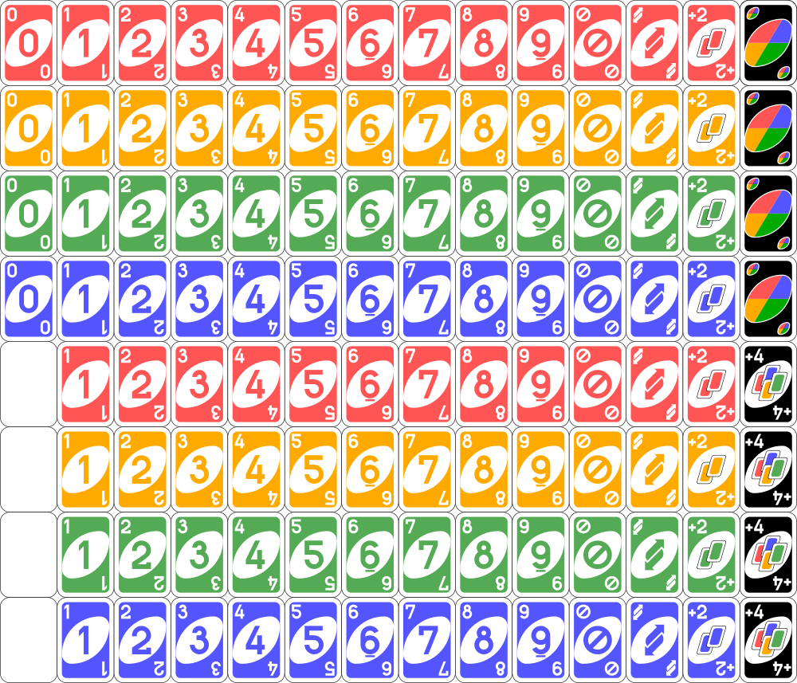
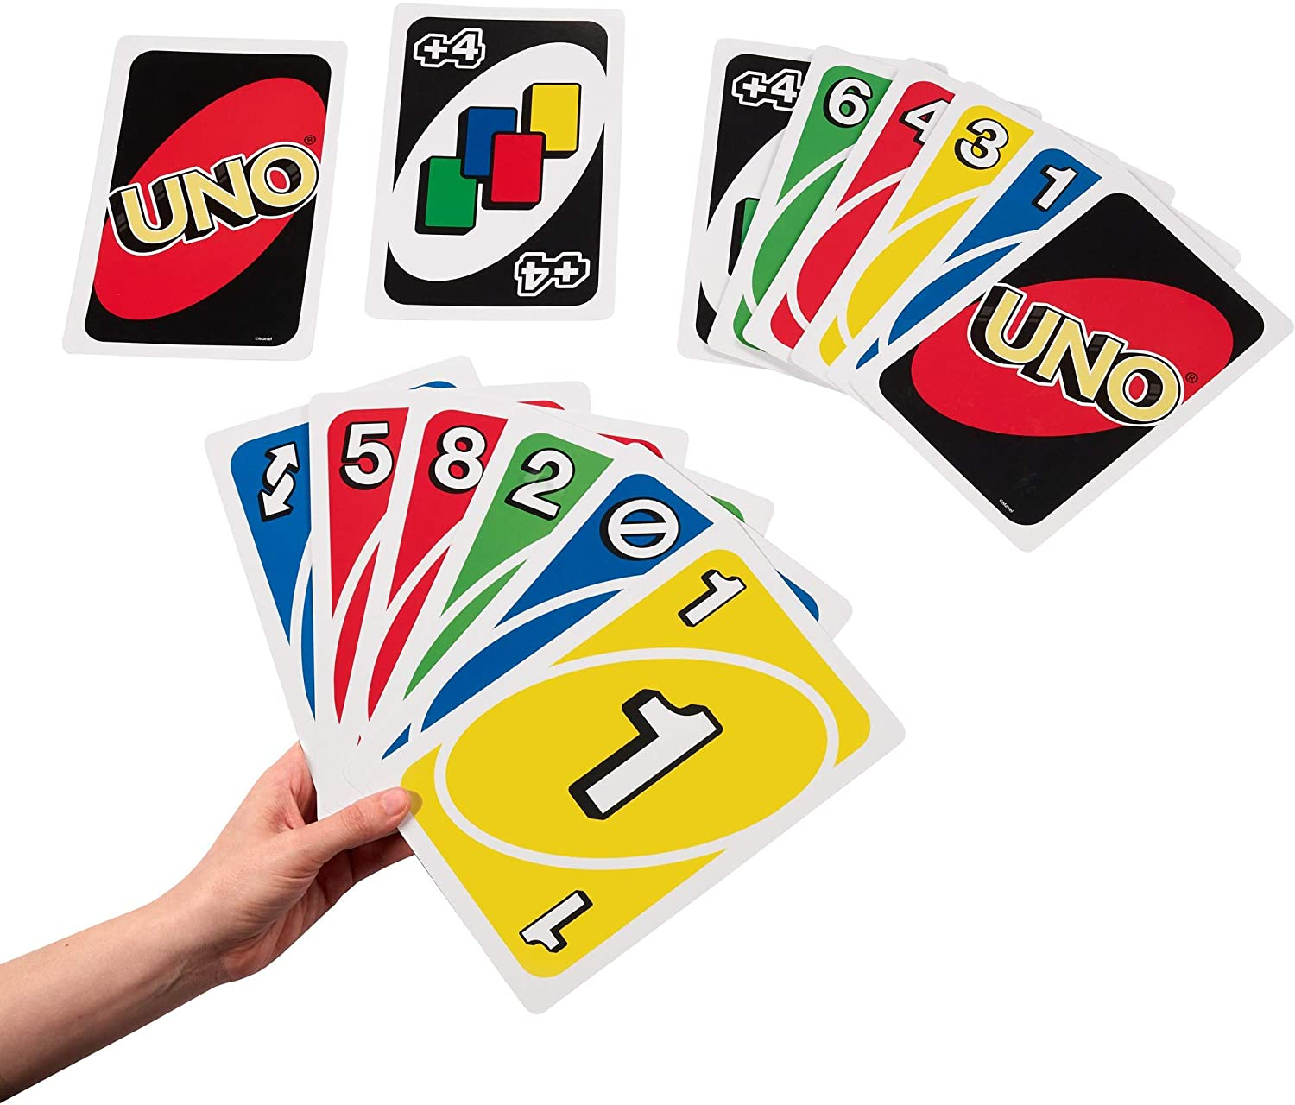
Project Specification
-create our own “UNO”
-What is “UNO”
-current progress
-our goal

Slide 3
CRC model
User Interface
Game Controller
DeckUseCase PlayerUseCase
Card Deck Player

Slide 4
Scenario Walk-through
1 initialization
2 check what we can play then play cards
3 no card playable and draw card

Slide 5
Skeleton program
Screen Sharing...

Slide 6
Contribution
Jialun Chen: Player.java
Xinyuan Wang: Controller.java and github structure
York Chen: Deckusecase.java
Yuezheuxan Zhu: PlayerUseCase.java and its tests
Wise Chua: Deck.java Unittest Github Structure
Ziqian Gao: Card.java
Yao Zhou: UI design

Slide 7
Future Expectation
- Optimizing basic settings
- Implementing more rules
- Developing more game mode

Slide 8
Reflection
was planning to make a more complicated TCG
should we use more interfaces instead of subclasses
should we add more entites and try to create more features
is our work allocation distributed evenly
are we still on-track

Slide 9
Our question
In CRC model, should the subclasses explicitly show their responsibilities that inherits from the superclass?
Is our code clear enough?
Is our project complicated enough?
Do we need to create more interface?

